Slide 1

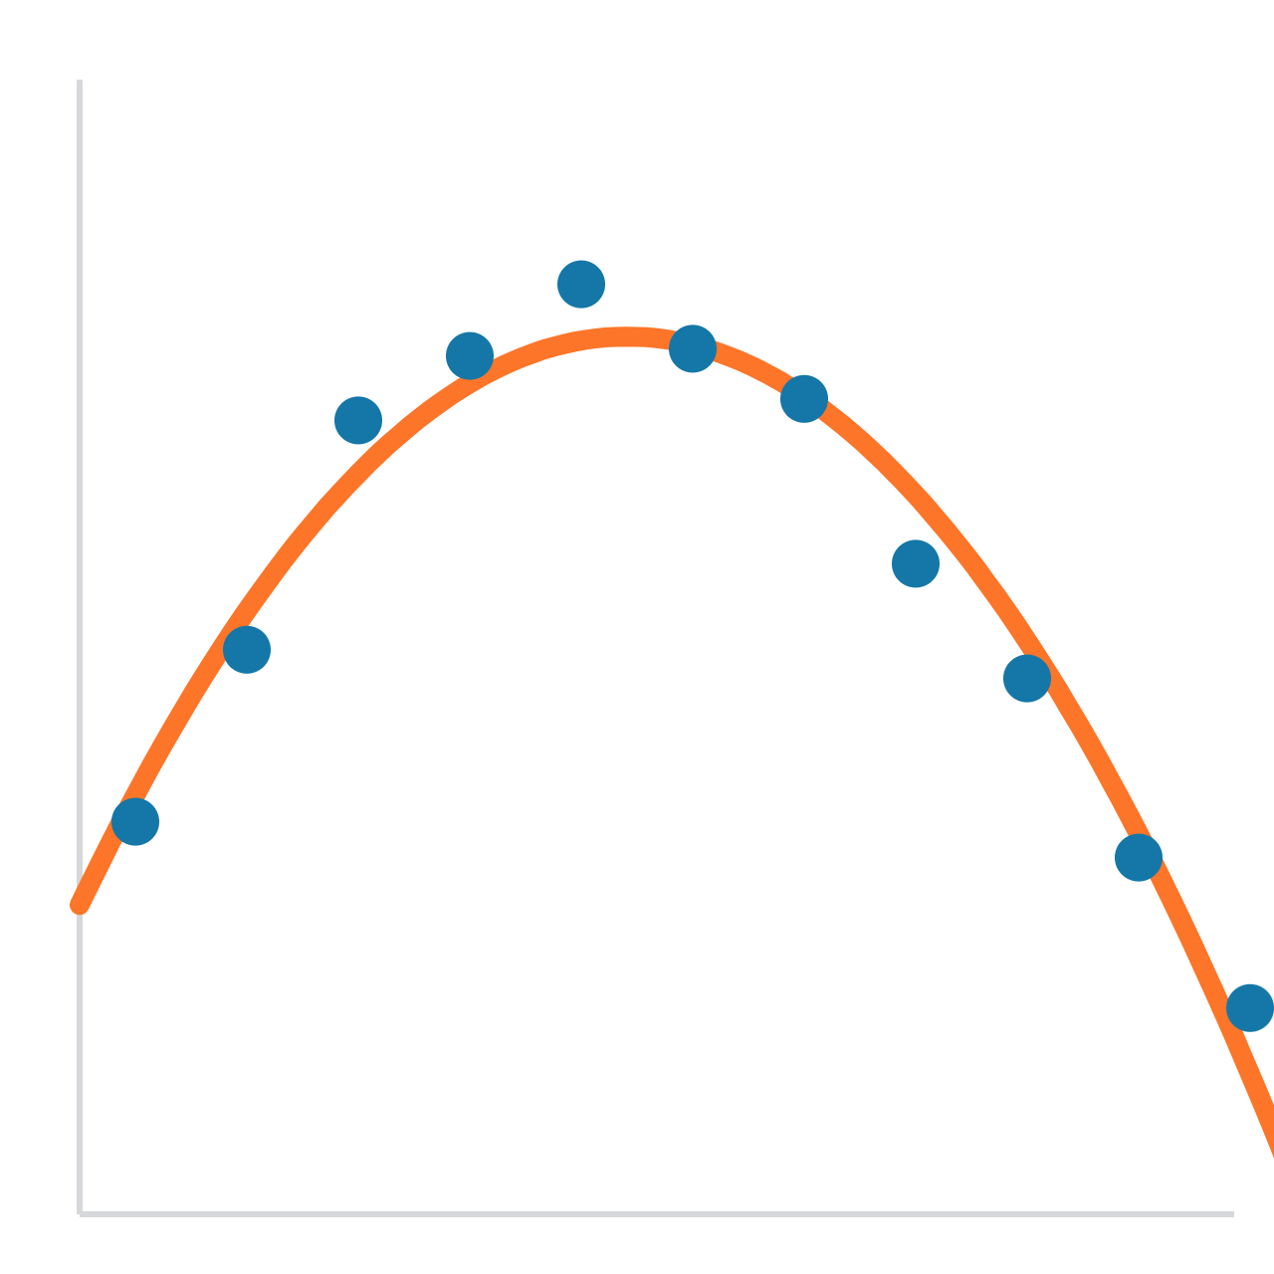
Polynomial regression, made simple
MACHINE LEARNING BASICS
When a straight line isn’t enough
Notes:
Welcome. Today’s idea: what to do when data curves and a straight line can’t follow it. By the end, everyone should be able to explain why adding x² makes a line bend, and how to pick the right amount of bending.

Slide 2

Regression predicts a number from data
QUICK RECAP
Input
Rule learned from data
Output
Speed: 60 km/h
y = a + b·x
Mileage: 18 km/l
What we know
a and b are found by training
What we predict
Linear regression finds the straight line that passes closest to all the points. Today: what if the points don’t lie on a straight line?
Notes:
Quick recap for anyone new. Regression = predicting a number. Linear regression draws a straight line y = a + b·x, and training finds a and b so the line sits as close to all the points as possible. Ask: what could go wrong with a straight line?

Slide 3
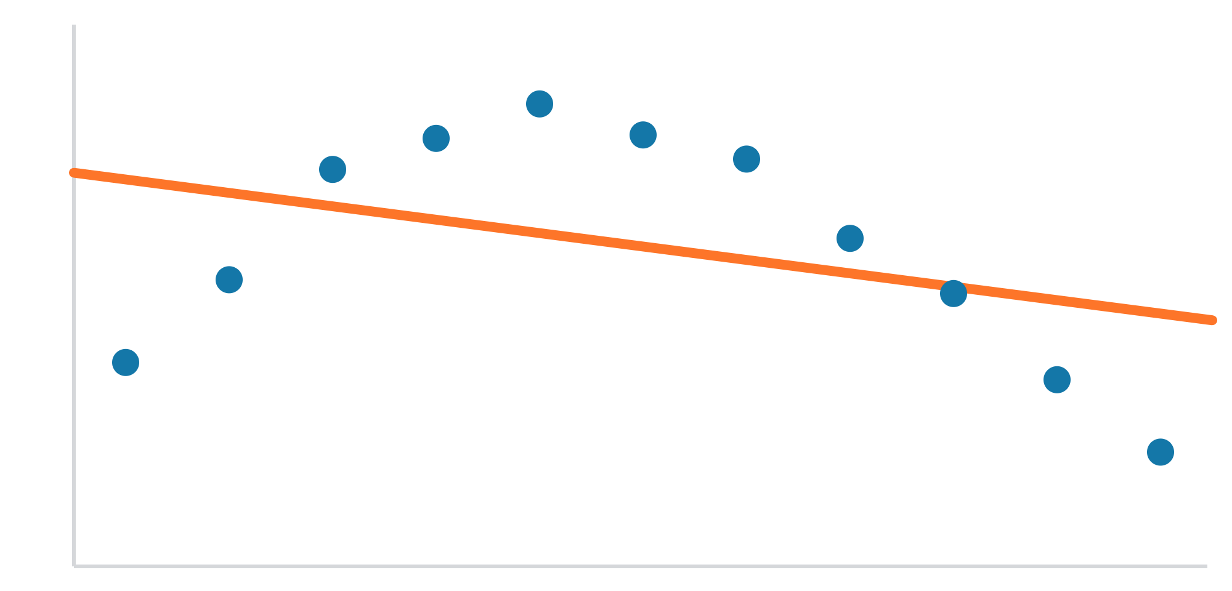
Real data often curves
THE PROBLEM
Speed (km/h) | Mileage (km/l)
20 | 11
40 | 16.5
60 | 18.5
80 | 16.8
100 | 13
120 | 8.5
Blue dots: real data. Orange: the best straight line. Speed runs left to right.
Mileage rises, peaks near 60 km/h, then falls. No straight line can follow a hill.
Notes:
Ask students to sketch these six points before showing the chart, then draw the best straight line they can. They’ll discover it fails on their own: it either tilts up or down and misses one side badly. Now they want a curve.

Slide 4
A straight line changes by the same amount every step
STEP 1 · WHY A LINE IS STRAIGHT
x | 0 | 1 | 2 | 3 | 4 | 5
y = 10x | 0 | 10 | 20 | 30 | 40 | 50
Change from previous step |  | +10 | +10 | +10 | +10 | +10
Same change every step means a straight line. It can tilt, but it can never turn around.
Notes:
Put y = 10x on the board. Ask: by how much does y change each step? Always 10. Constant change is what makes a line straight. Everything that follows builds on this.

Slide 5
x² changes by a growing amount every step
STEP 2 · MEET X²
x | 0 | 1 | 2 | 3 | 4 | 5
x² | 0 | 1 | 4 | 9 | 16 | 25
Change from previous step |  | +1 | +3 | +5 | +7 | +9
The change keeps growing, so x² curves. On its own, x² is always positive and always curves upward.
Notes:
Have students fill in the x² row and the change row themselves. Ask: what’s different from the straight line? The change keeps growing: +1, +3, +5, +7. Something whose change keeps growing can’t be straight. Plant the question now: x² is always positive, so how could it ever make a hill? We answer it in Step 4.

Slide 6
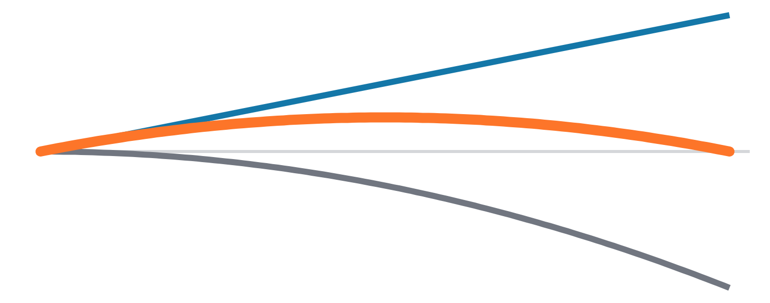
Add them together: y = 10x − x²
STEP 3 · THE TUG-OF-WAR
x | 0 | 2 | 4 | 5 | 6 | 8 | 10
10x (steady push up) | 0 | 20 | 40 | 50 | 60 | 80 | 100
−x² (growing pull down) | 0 | −4 | −16 | −25 | −36 | −64 | −100
y = total | 0 | 16 | 24 | 25 | 24 | 16 | 0
10x: pushes up by 10 every step
−x²: pulls down harder every step
Total: rises, peaks at 25, falls
Notes:
This is the heart of the session. Give students this table with the bottom row blank and let them add the columns. When 0, 16, 24, 25, 24, 16, 0 appears in their own handwriting, the bend clicks. At first the steady push wins, so y rises. The pull grows every step, catches up at x = 5, and then wins, so y falls.

Slide 7
The change of direction is the bend.
First the push wins and y rises. Then the pull wins and y falls. That’s all polynomial regression adds to a straight line.
Notes:
Pause here. Ask someone to explain in their own words why the total went up and then down. If they can, they’ve understood the core idea.

Slide 8
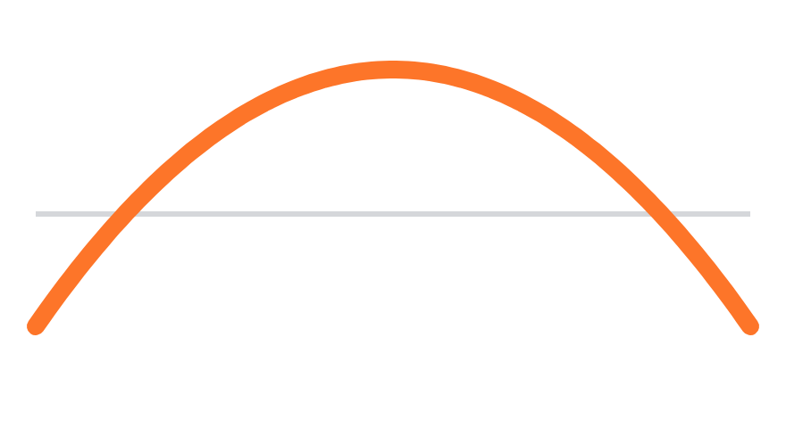
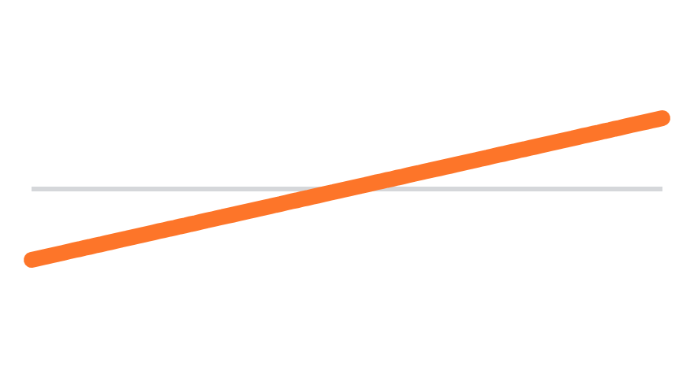
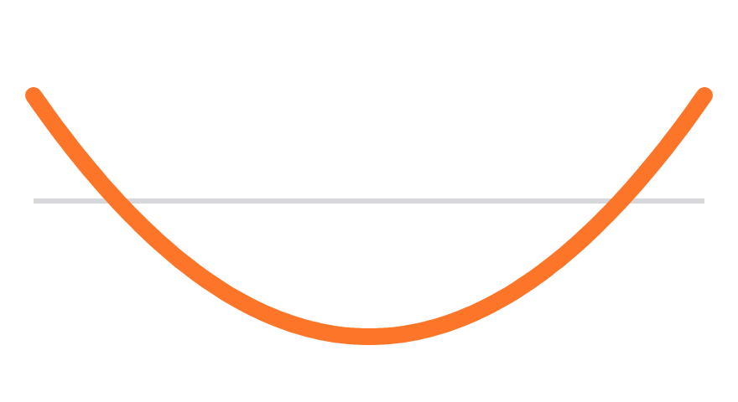
The sign of c decides hill or valley
STEP 4 · BUT X² IS ALWAYS POSITIVE?
c is negative
c is zero
c is positive
−1 × x² is always negative, so it pulls down: a hill
No x² at all: just a straight line
x² pushes up harder and harder: a valley
The model never uses x² alone. It uses c × x², and c can be any number, including negative.
Notes:
This answers the question from Step 2. x² alone is always positive, but the model multiplies it by c. A negative c flips it so it pulls down, giving a hill. Positive c gives a valley. The size of c sets how sharp the bend is. The b term decides where the peak lands left or right.

Slide 9
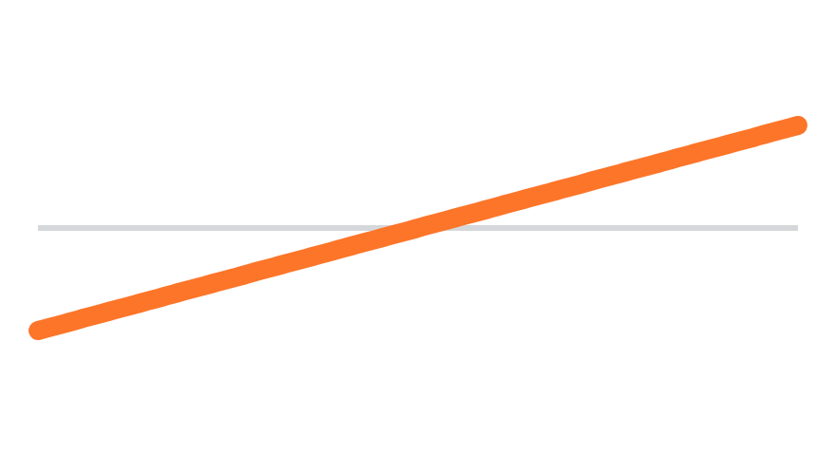
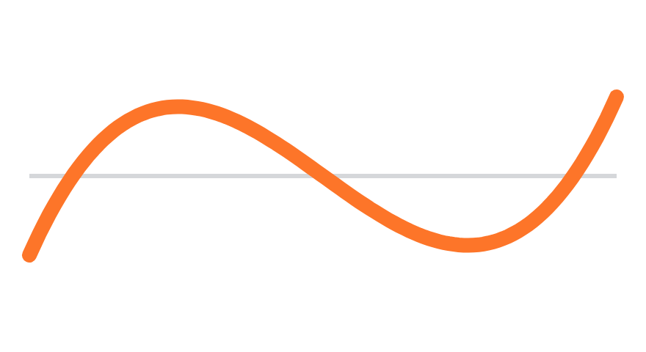
Each extra power allows one more bend
STEP 5 · HIGHER DEGREES
Degree 1: y = a + bx
Degree 2: + cx²
Degree 3: + dx³
No bends
Up to 1 bend
Up to 2 bends
Rule: degree n allows up to n − 1 bends.
Notes:
Each higher power grows faster than the one before. Mixing them, different terms win in different parts of the graph, and the curve changes direction each time the winner changes. More terms, more possible takeovers, more bends.

Slide 10
It’s still linear regression, with extra columns
UNDER THE HOOD
horsepower | hp² | hp³
130 | 16,900 | 2,197,000
150 | 22,500 | 3,375,000
165 | 27,225 | 4,492,125
poly = PolynomialFeatures(degree=3)
X_poly = poly.fit_transform(X)
Then plain LinearRegression runs on X_poly.
One column becomes three. The model learns one number per column.
“Linear” refers to a, b, c: they are only multiplied and added. The curve comes from the new columns.
Notes:
Common confusion: why is it still called linear regression? Because the model still just multiplies each column by a number and adds them up. The curving comes entirely from the extra columns we created. Point out how big hp³ gets; that’s why the notebook adds StandardScaler.

Slide 11
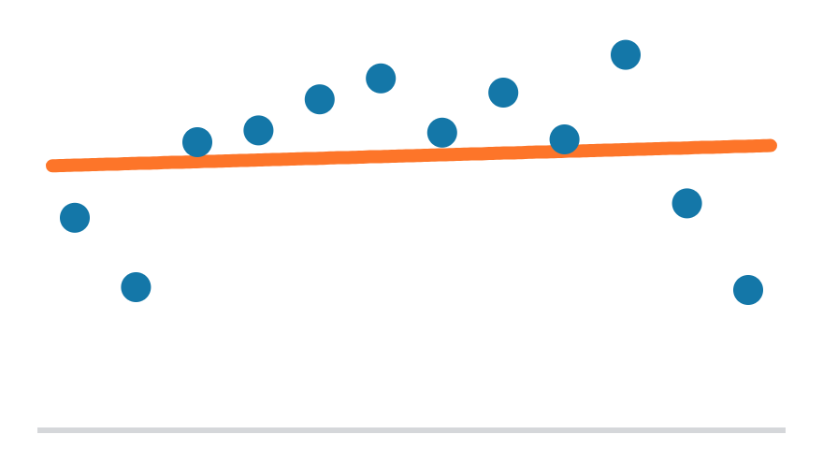
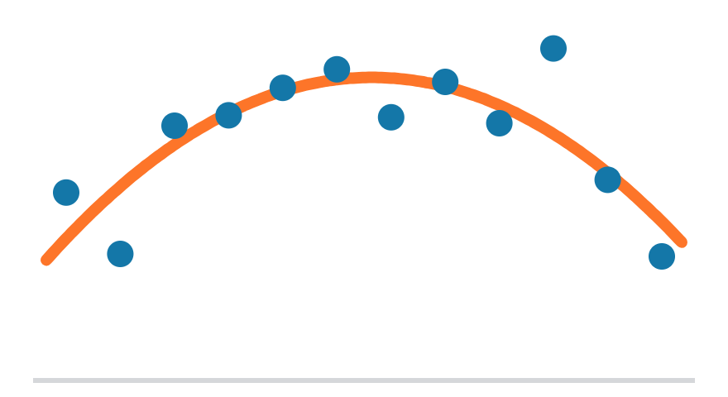
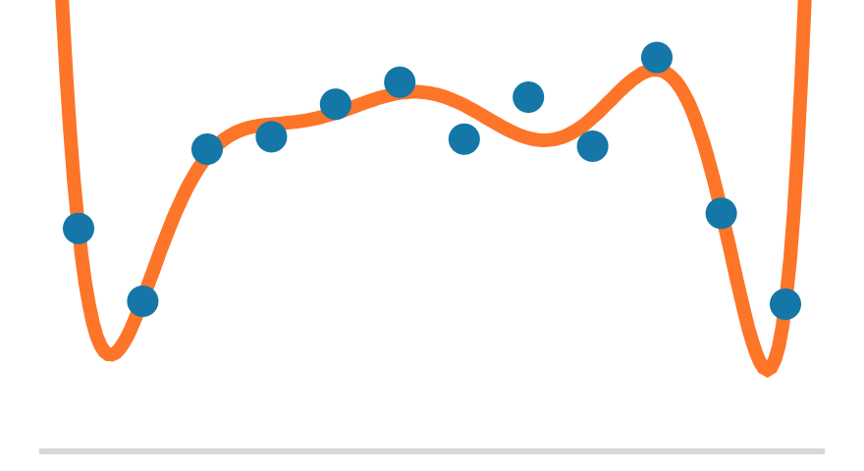
Too many bends means memorising noise
THE CATCH
Degree 1: underfit
Degree 2: good fit
Degree 9: overfit
Too simple. Misses the pattern.
Follows the real shape.
Chases every dot, including noise.
Lower error on training data isn’t always better. The real test is data the model has never seen.
Notes:
Ask: degree 9 touches almost every point, so is it the best model? Let them argue. Then ask what it would predict between or beyond the dots. The goal is enough bends to follow the real shape, not so many that it chases random noise.

Slide 12
Scoring on training data flatters bigger degrees
WHY CROSS-VALIDATION · PROBLEM 1
Degree | Score on training data | Score on hidden data
1 | 0.61 | 0.60
2 | 0.70 | 0.68
5 | 0.71 | 0.68
10 | 0.72 | 0.65
The training score rises with every extra degree, because more bends always hug the training points closer. Only the score on hidden data shows when extra bends stop helping.
Notes:
Real R² numbers from the notebook. If we scored on the data the model learned from, degree 10 would win every time: 0.61, 0.70, 0.71, 0.72, always going up. That’s overfitting in disguise. On hidden data, the score peaks at degree 2 and then drops. So each model must be scored on cars it didn’t learn from. Ask: which column would you trust to pick the degree?

Slide 13
One hidden chunk can give a lucky or unlucky score
WHY CROSS-VALIDATION · PROBLEM 2
Round 1
Round 2
Round 3
Round 4
Round 5
0.51
0.75
0.75
0.77
0.62
Unlucky chunk
Lucky chunk
Same model, same degree 2. Only the hidden chunk of cars changed. Tested just once, we might have seen 0.51 or 0.77, purely by chance.
Average of all five rounds: 0.68, a far more reliable number than any single round.
Notes:
These are the real five fold scores for degree 2 from the notebook. Nothing about the model changed between rounds, only which cars were hidden. Some chunks happen to contain easy cars, some contain a few odd ones. One test alone is partly luck; the average of five removes most of that luck. Ask: if you saw only Round 1, what would you conclude about degree 2?

Slide 14
Judge a batsman by his average, not by one match.
Cross-validation gives every degree five matches, then compares their averages.
Notes:
You wouldn’t pick a batsman for the team based on one innings: one great or terrible day says little. You look at his average across many matches. Cross-validation does the same for each degree: five tests, one average per degree, then compare averages.

Slide 15
GridSearchCV tries every degree and keeps the best
CHOOSING THE DEGREE
Step 1
Step 2
Step 3
Step 4
List the degrees
Split into 5 folds
Train and test 5 times
Keep the best
1, 2, 3 … 10
Training data only
Each fold is the test once
Highest average score wins
Round 1
Round 2
Test fold
Round 3
Training folds
Round 4
Repeated for every degree in the list
Round 5
Notes:
Walk through one round: train on the 4 grey parts, test on the orange part. Shift and repeat 5 times so every part is tested once, then average. Do this for every degree. With 10 degrees, that’s 50 models trained behind the scenes. The test set from train_test_split is never touched here.

Slide 16
Every degree faces the same five tests
A FAIR COMPARISON
Degree | Round 1 | Round 2 | Round 3 | Round 4 | Round 5 | Average
1 | 0.45 | 0.68 | 0.63 | 0.68 | 0.55 | 0.60
2 | 0.51 | 0.75 | 0.75 | 0.77 | 0.62 | 0.68 (best)
10 | 0.37 | 0.72 | 0.69 | 0.80 | 0.64 | 0.65
Real cross-validation R² scores from the Auto MPG notebook.
Degree 10 wins Round 4, but degree 2 has the best average. Judged on one round alone, we would have picked the wrong degree.
Notes:
Every degree is tested on exactly the same five chunks, so the comparison is apples to apples. Point at Round 4: degree 10 scores 0.80 there, the highest number in the table. If that were the only test, degree 10 would win. But it does badly in Round 1 (0.37), and its average is lower. Degree 2 is steady across rounds and has the best average, so GridSearchCV picks it.

Slide 17
The test set is saved for the final exam
KEEPING IT HONEST
Training data · 313 cars
Test · 79
GridSearchCV works only inside here
Untouched
During the search
After the search
10 degrees × 5 rounds = 50 models, all trained and scored inside the training data. Result: degree 2.
Degree 2 is retrained on all 313 cars, then scored once on the 79 test cars. Result: R² 0.64.
If the test set helps choose the degree, it is no longer unseen data, and its score can’t be trusted.
Notes:
Two levels of hiding. Cross-validation hides chunks of the training data to choose the degree. The test set is hidden from everything, including the search, and is used exactly once at the end. Analogy: practice tests help you prepare (cross-validation); the final exam paper must be one you have never seen (the test set). If you peek at the final paper while preparing, your exam score no longer means much.

Slide 18
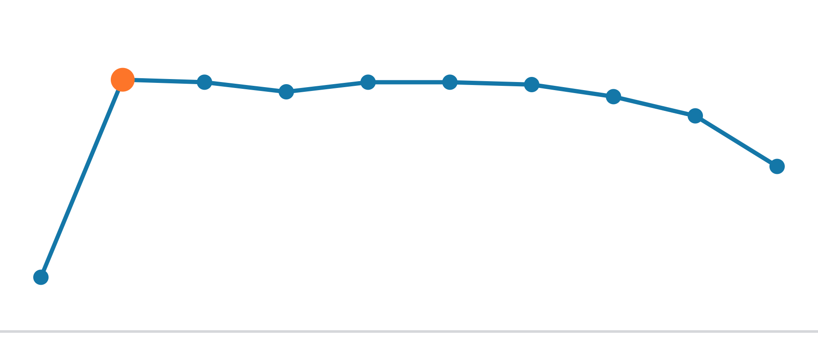
Degree 2 wins on cars it has never seen
ON THE AUTO MPG DATASET
0.57
Straight line, test R²
0.64
Degree 2, test R²
1
2
3
4
5
6
7
8
9
10
2
Average cross-validation R² per degree (higher is better). Big jump at 2, then flat.
Best degree chosen by GridSearchCV
Notes:
These are the real numbers from the notebook: horsepower predicting mpg. The straight line explains about 57% of the variation, degree 2 about 64%. GridSearchCV picks degree 2 because the score jumps there and then stops improving. If two degrees score about the same, prefer the simpler one.

Slide 19
The whole workflow in a few lines
IN CODE
model = Pipeline([
("poly", PolynomialFeatures()),
("scaler", StandardScaler()),
("linreg", LinearRegression())
])
grid = GridSearchCV(model, {"poly__degree": list(range(1, 11))}, cv=5)
grid.fit(X_train, y_train)
print(grid.best_params_) # {'poly__degree': 2}
print(grid.score(X_test, y_test)) # R² on unseen data
poly__degree
cv=5
.score()
The degree setting inside the step named poly
Five-fold cross-validation
R²: 1 is perfect, 0 is no better than the average
Notes:
This mirrors Step 8 of the notebook. The double underscore in poly__degree means: inside the step named poly, change its degree. score gives R² for regression models.

Slide 20
Three questions to close
CHECK YOUR UNDERSTANDING
1
2
3
Tiredness rises slowly at first, then faster and faster. Degree 1 or 2? Why?
x² is always positive. How can a model with x² draw a hill?
Degree 15 has the lowest training error. Is it the best model?
Notes:
Answers. 1: Degree 2. The rate of change keeps growing, which is exactly what x² does; a straight line changes at a constant rate. 2: The model uses c × x², and training picks a negative c, which turns the push into a pull. 3: Not necessarily. Low training error can mean it memorised noise. Judge it by cross-validation and test data, which is what GridSearchCV does.

